Slide 1
Prelim 1 Review
Prelim 1 Posting on Thursday
Due on Tuesday 11 pm on 3/26.

Slide 2
General Question
Test format: What types of questions should we expect?
Short answer
multiple choice questions
Short problems
How far should we be able to extrapolate beyond what is in the notes?
You should understand the fundamental concepts and be able to talk about those concepts with your friends

Slide 3
Python based Prelim
What could fail?
Communication with other humans during the exam about the exam
Post questions or answers on the web
Delete part of the exam by mistake (save a copy with your name in the title as step 1)
How do you minimize risk of failure?
Remember you are taking an exam!
Save versions

Slide 4
Flocculation Musings
What is optimal number of flocculator flow expansions in parallel? (1, 2, infinite?)
What is the goal of surface water treatment?
No one has ever optimized the design of a water treatment plant.
What are tradeoff’s between floc blankets and flocculators?
What are the strengths of each process?
How would you determine the optimal flocculator size?
Notes:
As W_jet decreases the maximum energy dissipation rate increases!
As the number of jets increases the distance that it has to expand before intersecting with the neighboring jet decreases.
Remove all primary particles
Set dC/dt for both processes equal. Flocculator gets increasingly expensive as we seek to produce lower and lower concentrations.
Floc blanket has constant cost per pC*. At some point those two costs intersect.

Slide 5
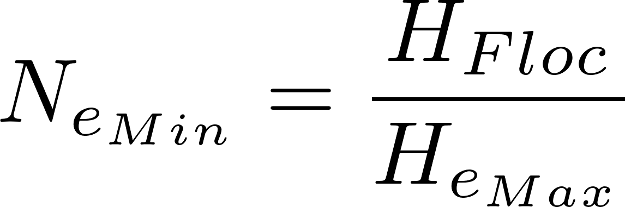
Flocculator elevations (as if it were one long channel)
Freeboard
Flocculator head loss
Water depth of sed tank inlet
S
We ignore triangle of fluid caused by head loss when calculating residence time
0.4S
H_{Floc}
S
S

Slide 6
Why is the AguaClara design so different from traditional designs?
Why lower G_{CS}θ?
Uniform velocity gradient
Close to plug flow (no short circuiting)
Why not tapered G_{CS}?
Why much higher G_{CS}?
Why can’t H/S be less than 2?
What is wrong with H/S greater than 6?
Notes:
Lower Gt because 1) more uniform 2) close to plug flow 3) floc blanket is next!
Tapered means less efficient use of energy. Tapered assumes that the goal is to make big flocs. That isn’t our goal.
We use a higher G so we can reduce the flocculator volume

Slide 7
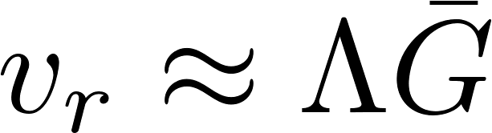
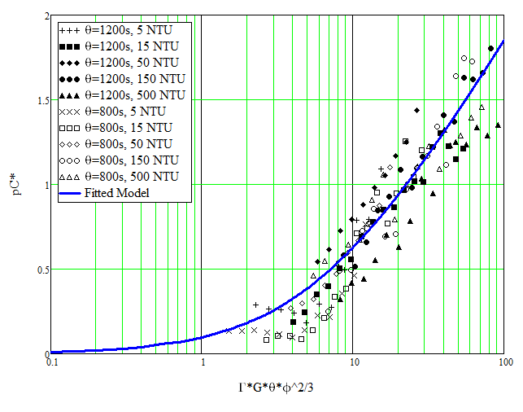
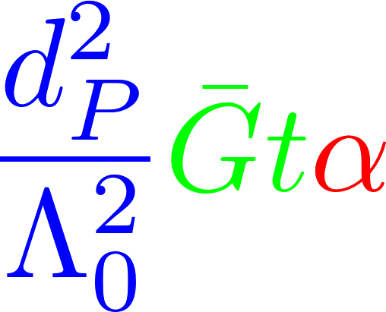
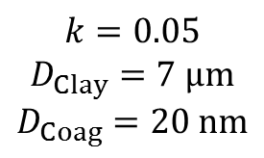
Separation Distance Scaling
$$k=0.05$$
$$D_{Clay}=7 μm$$
$$D_{Coag}=20 nm$$

Slide 8
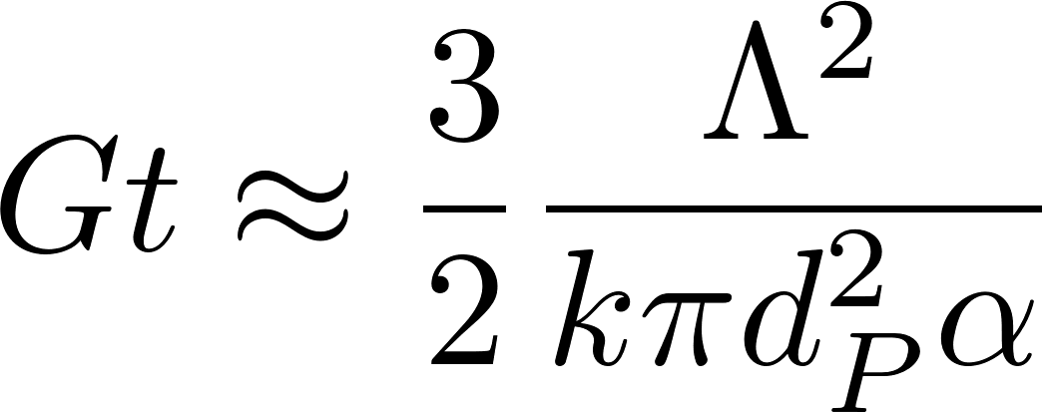
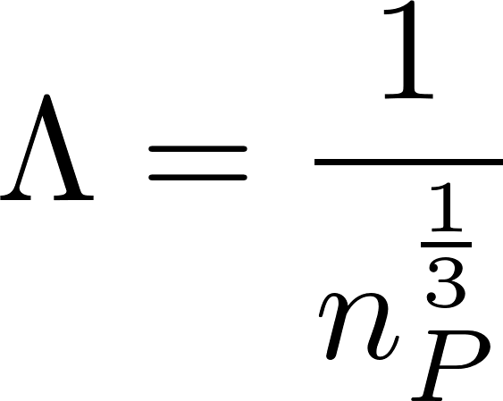
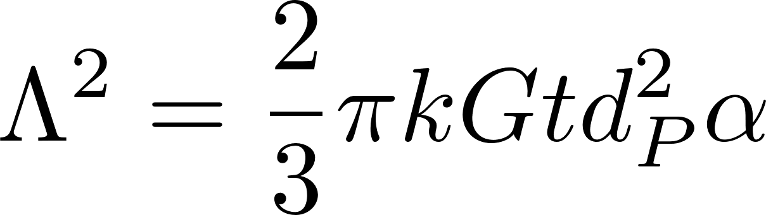
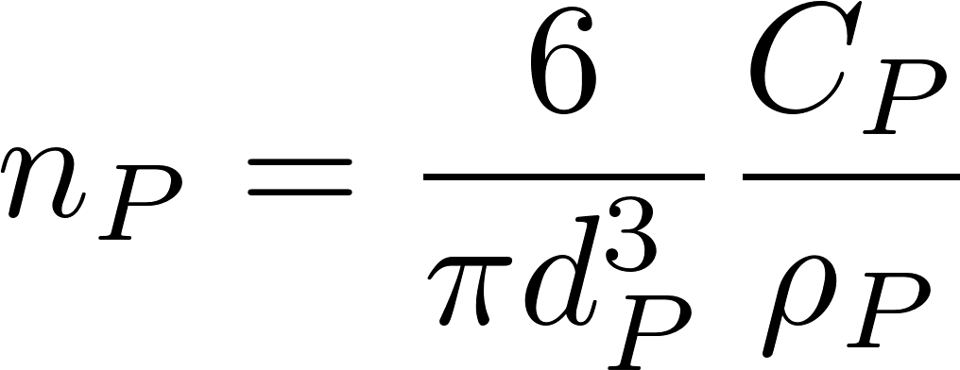
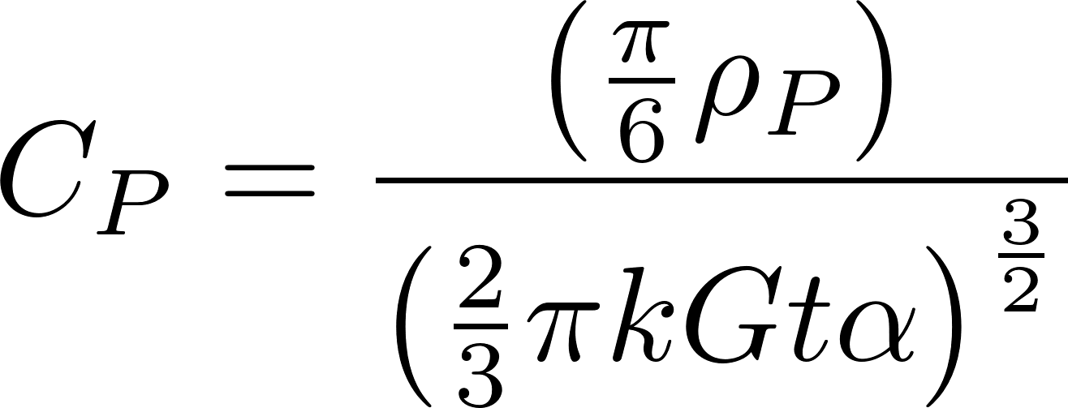
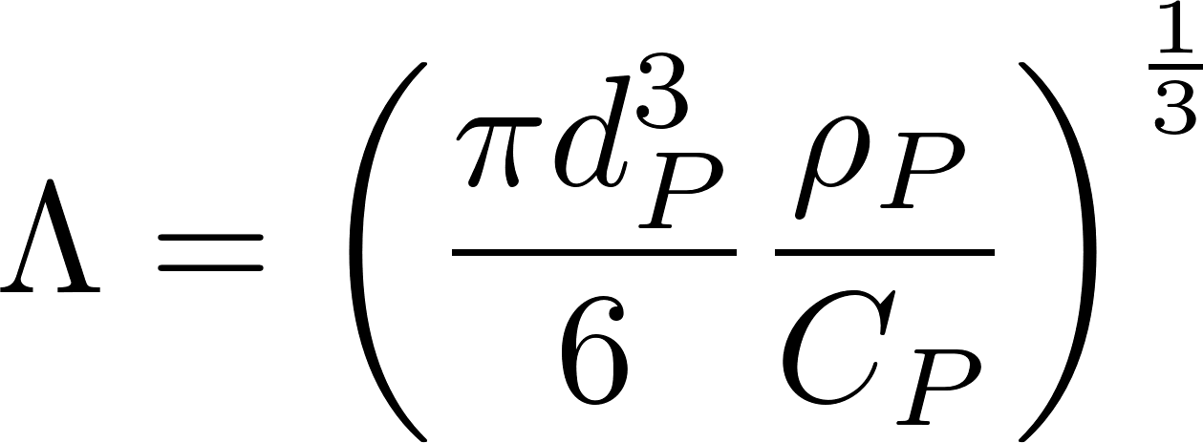
Primary particle concentration
k determined by William Pennock to have a value of about 0.03.
Clay diameter assumed to be 7 micrometer
68 NTU = 100 mg/L Kaolin clay
Coagulant nanoparticles = 90 nm in diameter

Slide 9
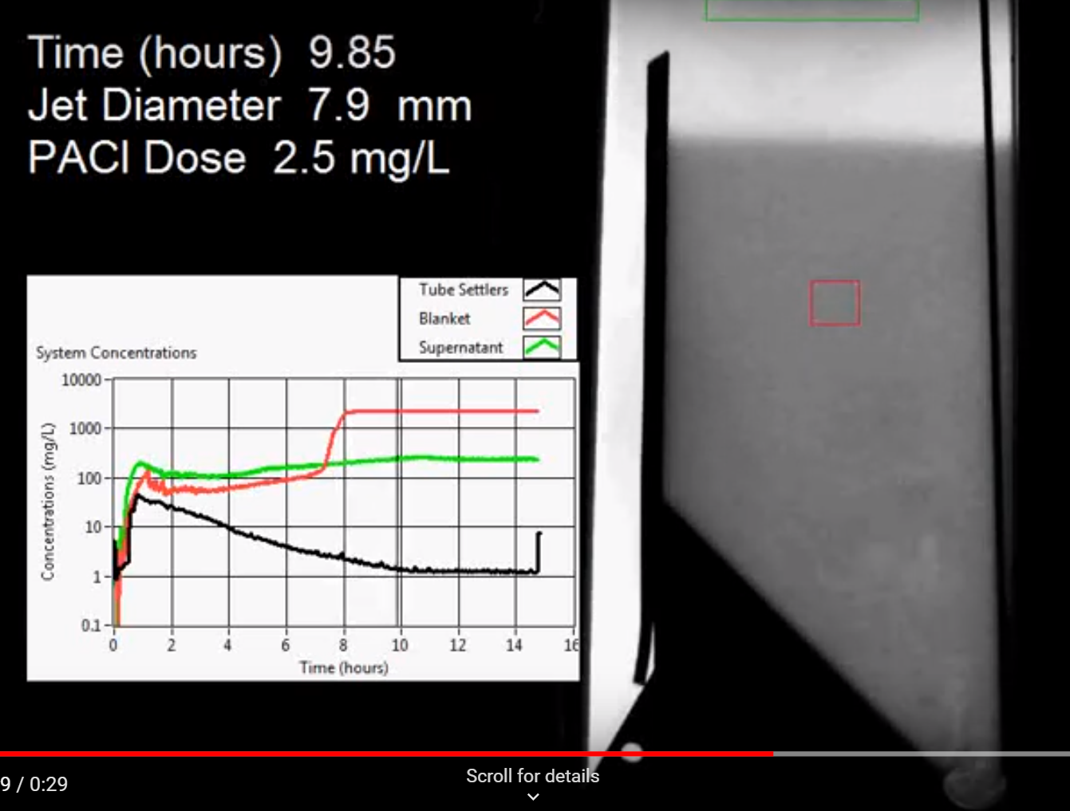
Turbidity stops decreasing before floc blanket stops growing!
Notes:
How does the floc blanket remove small particles?
Are plate settlers needed after a floc blanket?
What determines how fast the floc/water interface rises? 100mg/L*1mm/s = 3000 mg/L * x mm/s
Why might a floc blanket reduce settled water turbidity?
How is water entering the tank?
Where do the solids eventually go?
What mechanisms could result in particle aggregation in a floc blanket?
It’s a filter
It’s a flocculator
Wait, filters and flocculators are really quite similar. (particles colliding and attaching)
New question: which flocs are active and which flocs are inactive in the floc blanket?

Slide 10
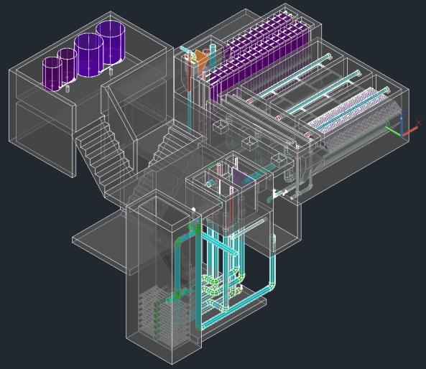

Slide 11
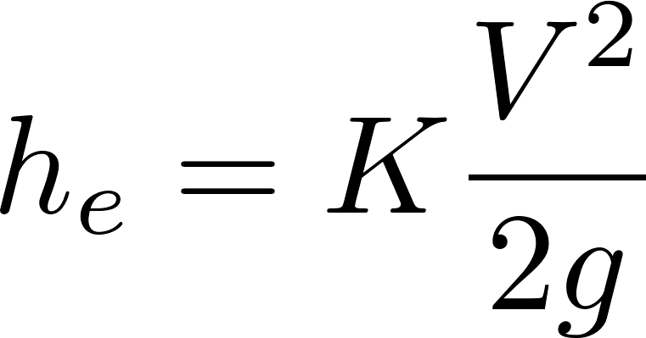
What are examples of major and minor losses?
Major: Caused by shear with the solid surface
Pipe walls
Flocculator baffle surfaces (insignificant)
Minor: Flow expansions (analogous to pressure drag)
Orifice, elbow, valve, any place where flow is expanding!
KE is converted into 2 things!
Velocity
Shear (wall on fluid)

Slide 12
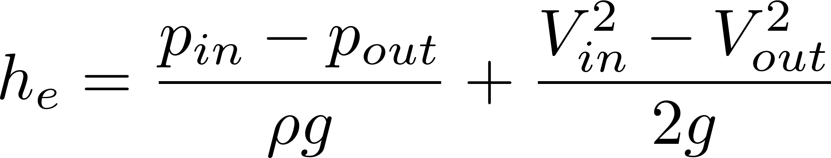
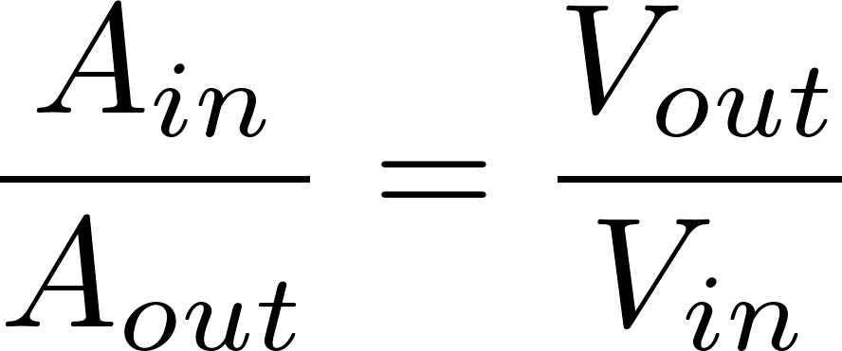
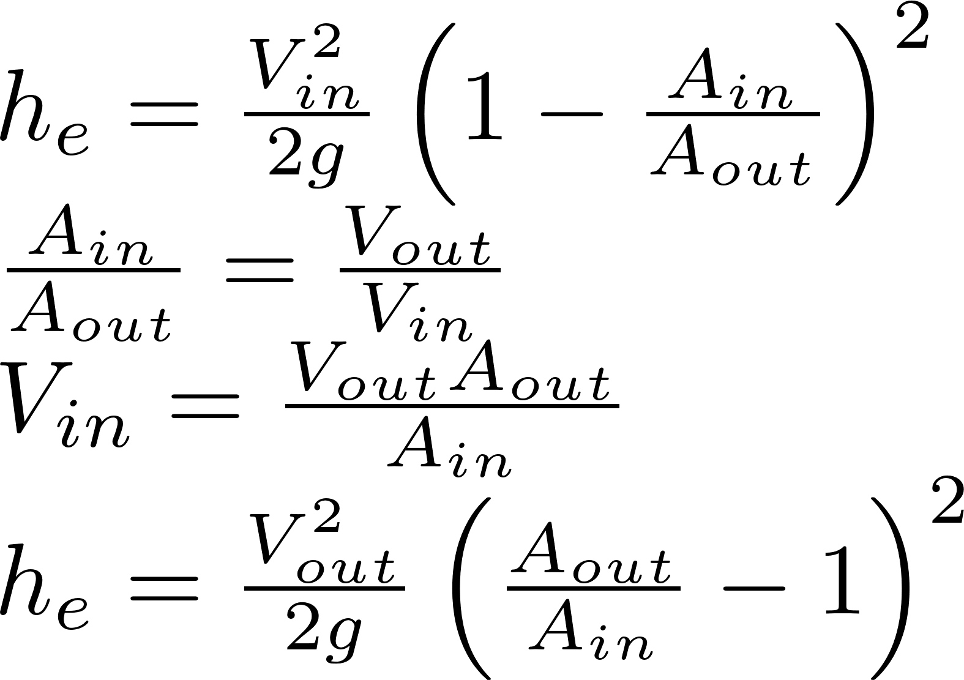
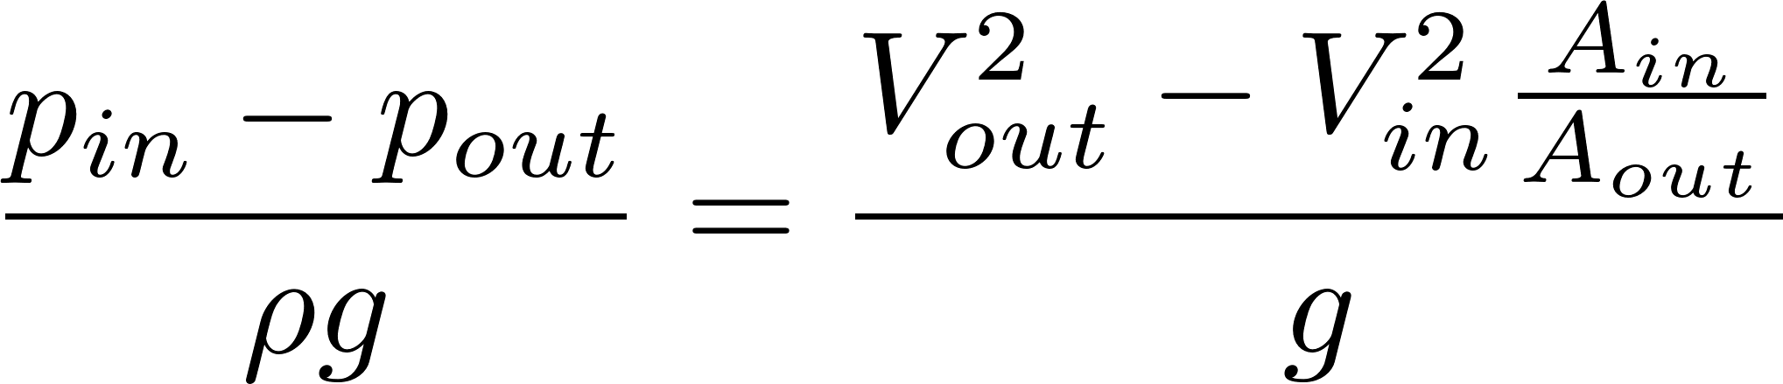
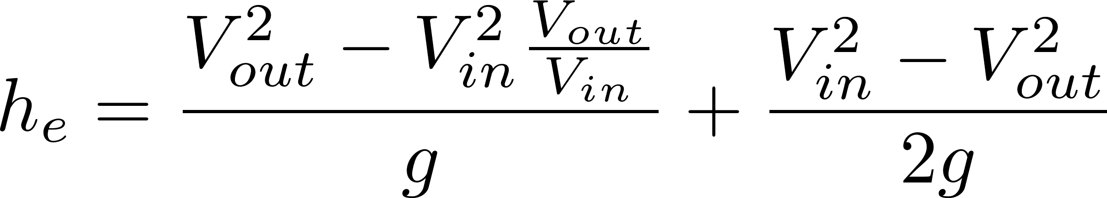
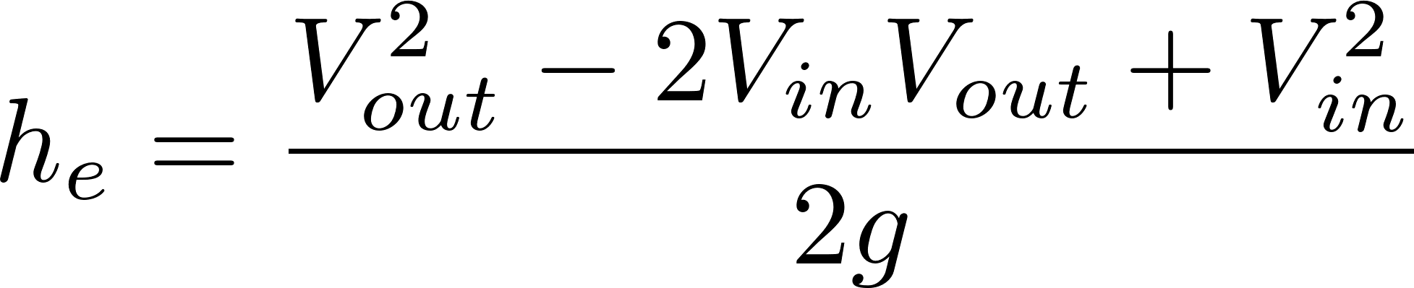
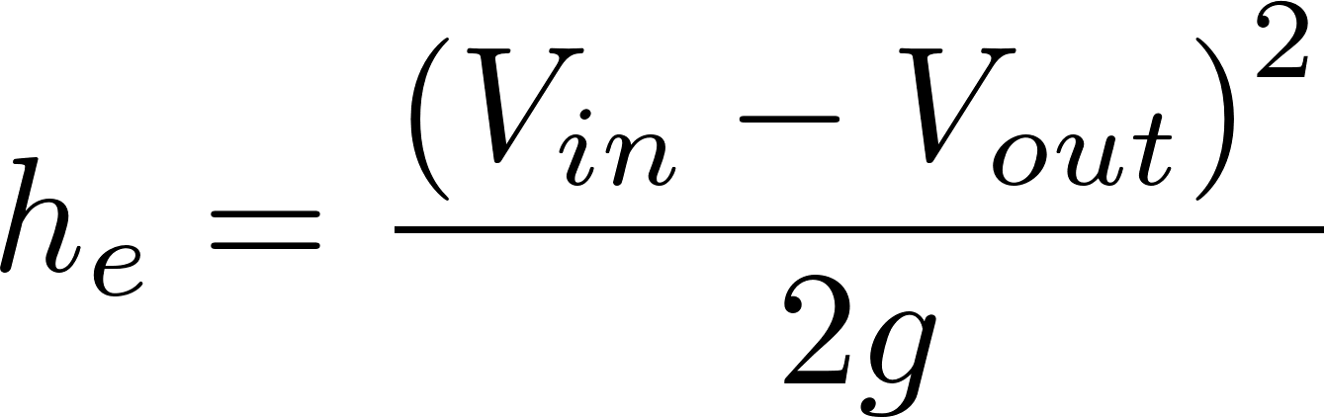
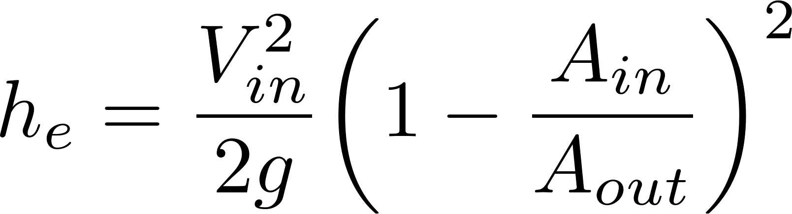
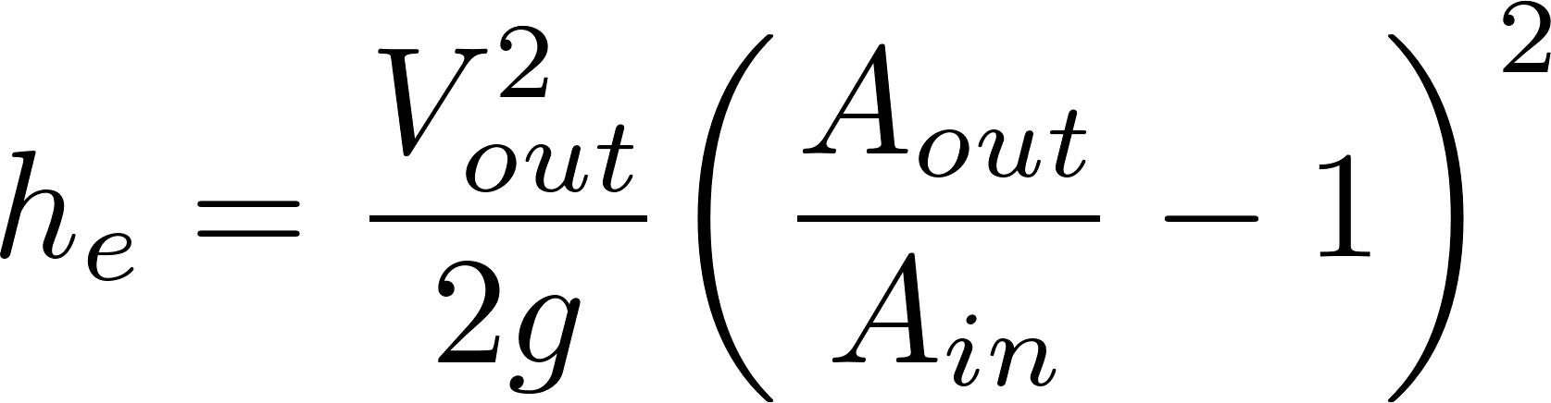
Head Loss due to Sudden Expansion
Energy
Mass
Momentum
2
2
2
K_{e}
K_{e}’
Discharge into a reservoir?__________________
Loss coefficient = 1
Notes:
Emphasize the minor loss coefficient is defined based on some relevant velocity. We can chose either V1 or V2. But the magnitude of the minor loss coefficient is determined by which velocity we use. We need to choose one and be consistent. The velocity that we choose will be a function of convenience. Minor losses are proportional to the square of the velocity. This is true whether the flow is turbulent or laminar!

Slide 13


The Challenge of Chemical Metering (Hypochlorinator)
What is the simplest representation that captures the fluid mechanics of this system?
Access door to hypochlorinator tank
Overflow tube
Chlorine solution
Access door to distribution tank
PVC valve
PVC pipe
Chlorine drip
Raw water entering distribution tank

Slide 14

Hole in a bucket (tank drain)
What type of head loss (major or minor)?
What is the equation for those loses?
How would you calculate the initial flow rate given the minor losses?
How does the flow vary with time?
What is the average flow rate while the tank is emptying?
Notes:
Minor
Minor loss equation
Solve for V and note that Q=VA
Flow decreases linearly with time
Average Q is ½ of initial Q.

Slide 15
Hole in a bucket (tank drain)
Case 2, h₀=1 m, h_{tank} = 1 m, t_{design}=4 days

Slide 16
What happens if raw water temperature drops in a WTP?
Flow measurement
Chemical feed (air temperature?)
Rapid mix
Flocculation
Head loss through flocculator
Fluid deformation (Gθ)
Sedimentation – prelim 2!
Notes:
Flow measurement (no change in minor head loss)
Chemical feed (air temperature?) If stock chemicals chill, then increased viscosity gives lower chemical flow rate.
Rapid mix (both diffusion and fluid deformation will slow down)
Flocculation
Head loss through flocculator (no change)
Fluid deformation (Gθ) (decrease in G)
Sedimentation (decrease in sedimentation rate)

Slide 17

Constant head tank
Stock Tank of coagulant
Lever
Slider
H
Float valve
LFOM
Open channel supercritical flow
Drop tube
Float
Dosing tubes
Purge valves
Notes:
Why is Q vs depth of water linear for the entrance tank?
Why is Q vs H linear for the coagulant?

Slide 18
Decrease dose
H

Slide 19
Increase dose
H

Slide 20
Half flow
H

Slide 21
Plant off

Slide 22


Where is this equipment in the new design?

Slide 23


Slide 24
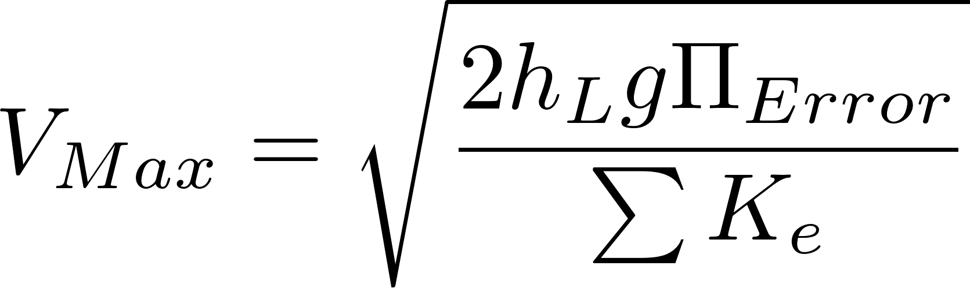
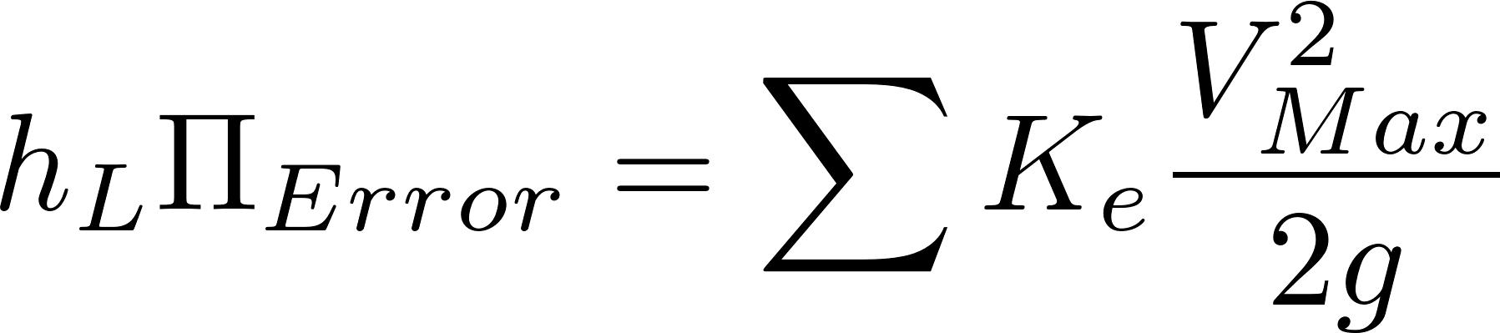
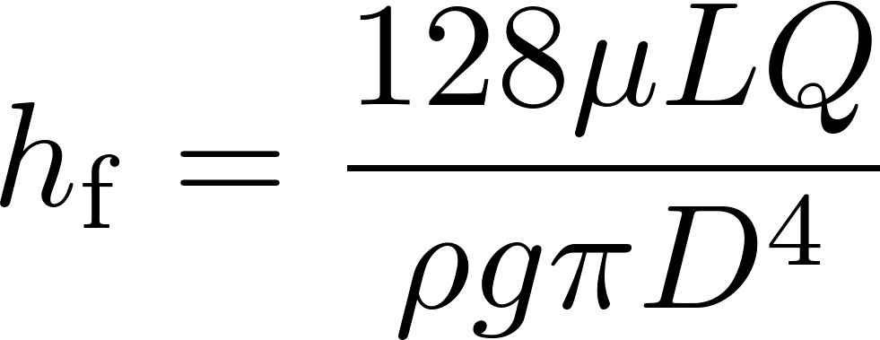

Chemical Dose Controller
What is the purpose of CHT?
What is the purpose of the dosing tubes?
What is the design constraint for the maximum flow rate in the dosing tubes?
Why does the flow through the dose controller increase if the plant flow rate increases?

Slide 25
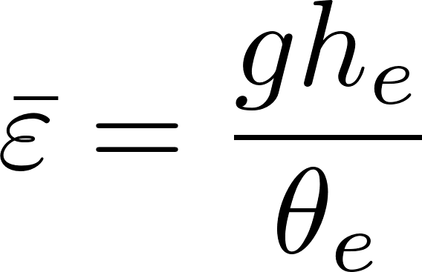
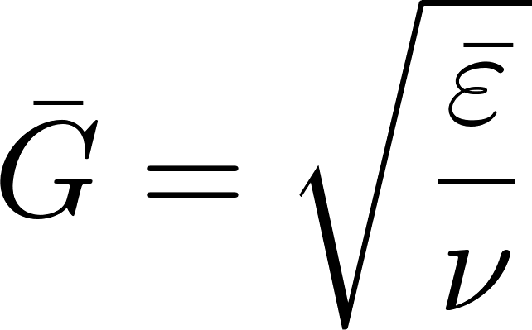
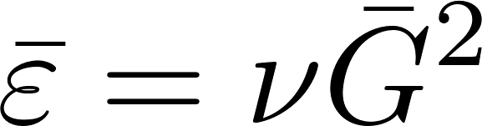
Head loss, energy dissipation rate, velocity gradient
Use these equations to relate velocity gradient to velocity (and then to flow geometry)

Slide 26
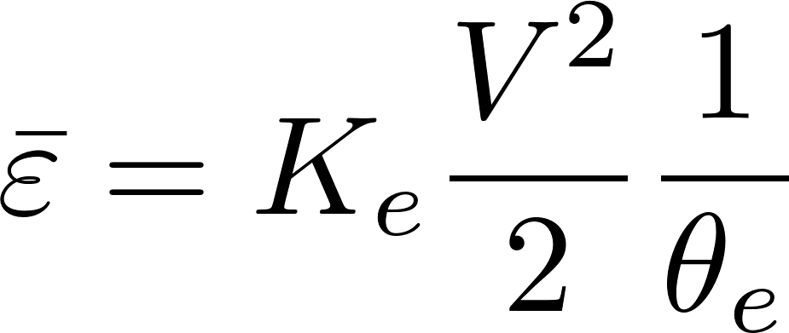
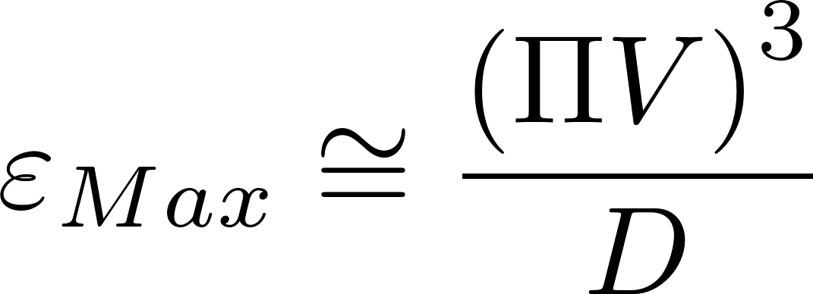
Energy dissipation rate
ε | Equation source | Equation | scale
Ave | Control volume mass momentum energy |  | time over which energy is dissipated
Max | Dimensional analysis |  | Flow dimension

Slide 27
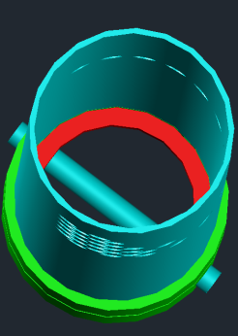
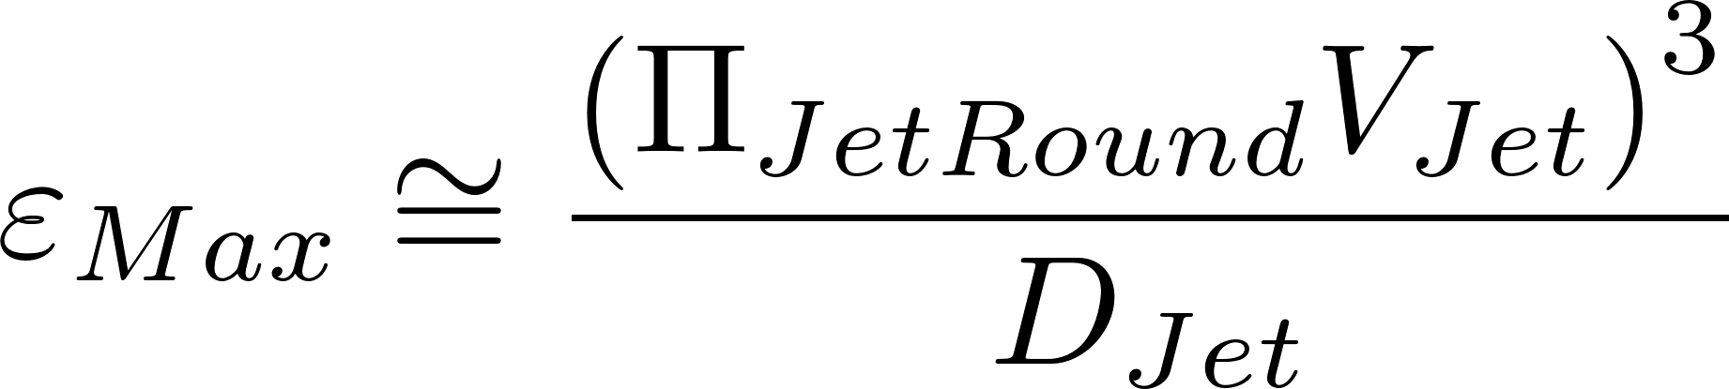

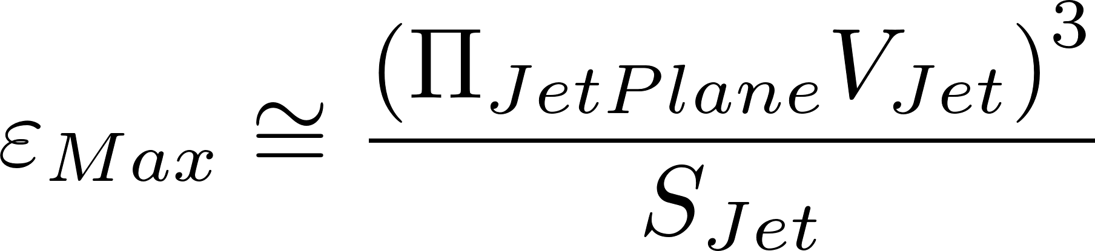
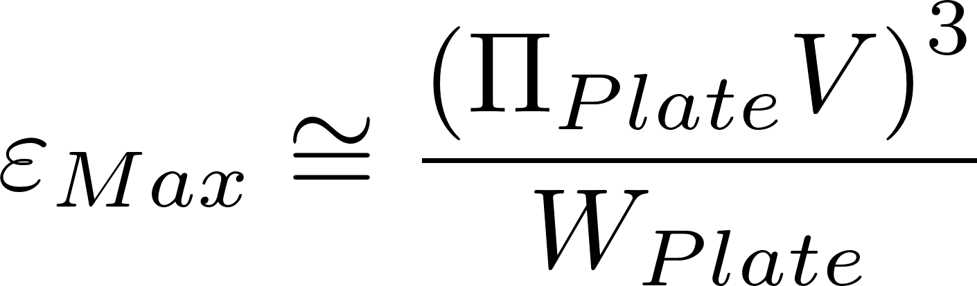
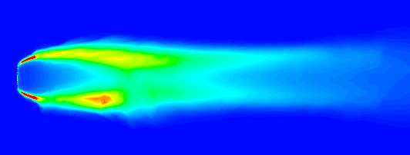
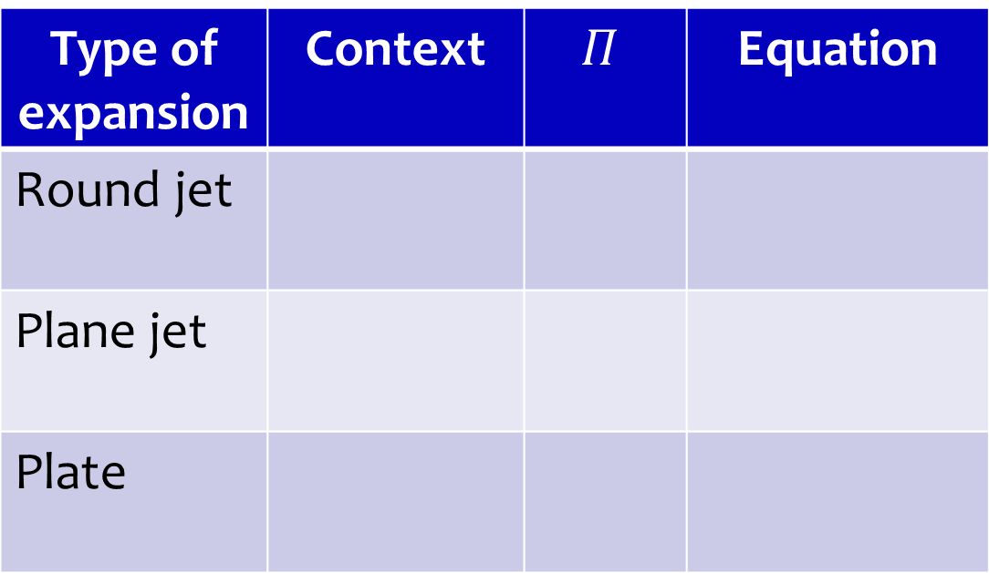
Maximum Energy Dissipation Rate
Type of expansion | Context | $$Π$$ | Equation
Round jet
Plane jet
Plate
Rapid mix
0.5
Hydraulic flocculator
0.225
Mechanical flocculator
0.34

Slide 28
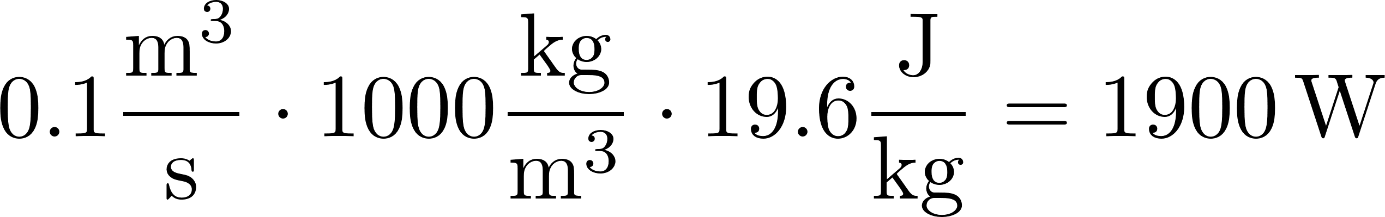
Power and Energy
Energy: Joule = Newton*meter
Power: Watt = Joule/s
Water elevation change in an AguaClara plant is about 2 m. How much energy are we using per kg of water?
If the flow rate is 100 L/s, what is the equivalent power?
Desalination = 1 km, distillation = 250 km
2m*g = 19.6 (m/s)^2 = J/kg
Notes:
2m*g = 19.6 (m/s)^2 = J/kg
0.1m^3/s*1000kg/m^3*19.6J/kg = 1.9 kW

Slide 29
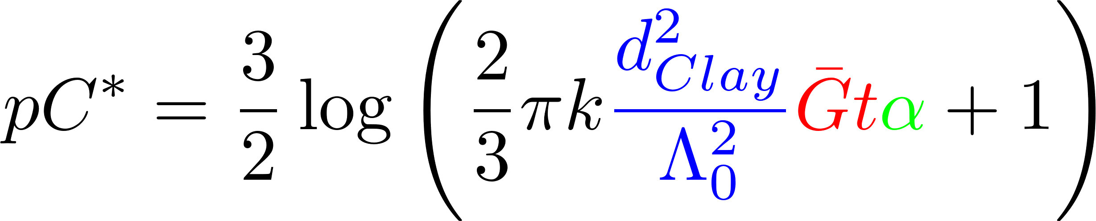
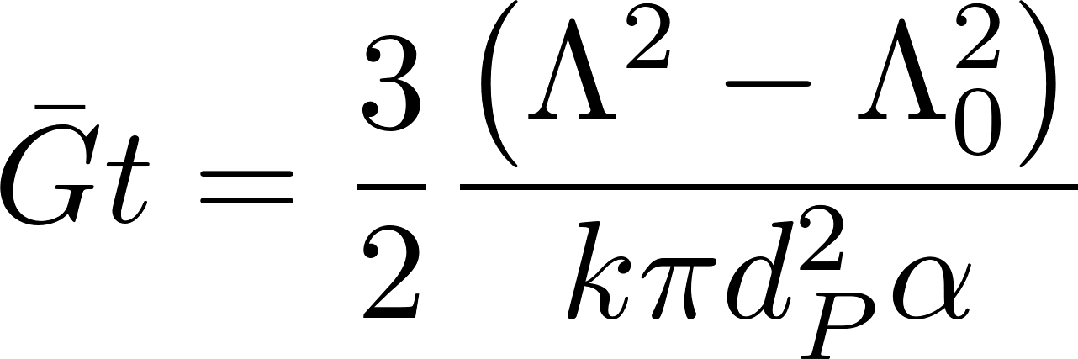
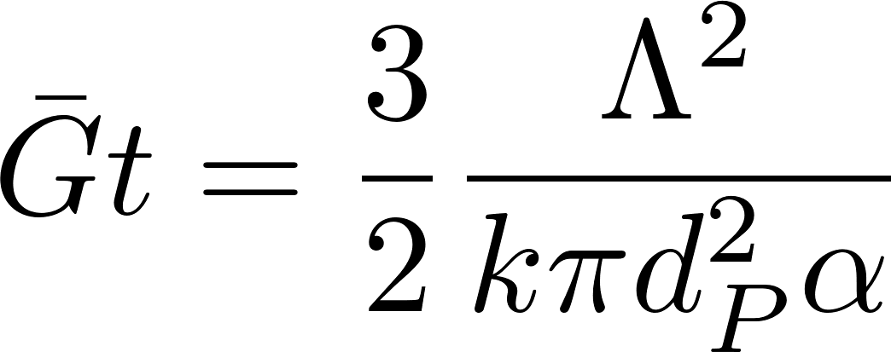
Identify all of the parameters in the Floc Model

